Slide 1

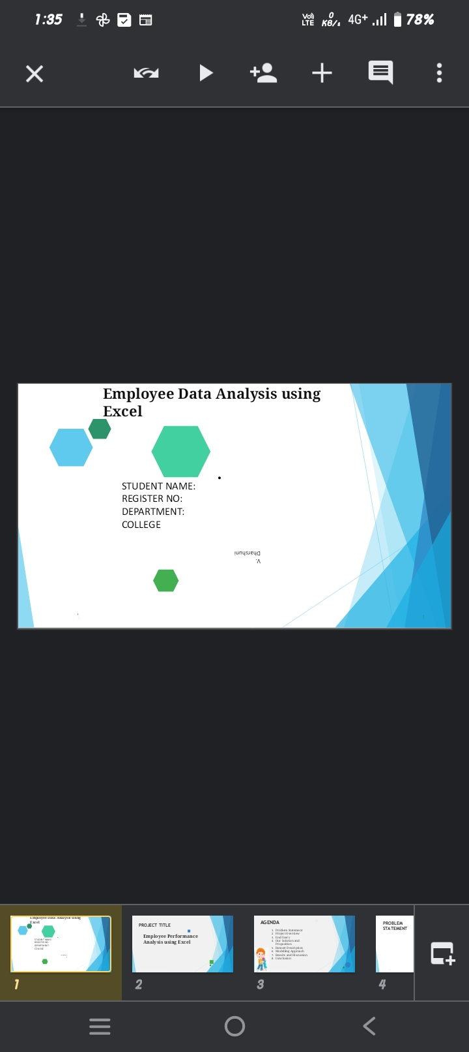
Name : v.Dharshini
Reg no : 312213463,asunm1455312213463
Department : B.com (general)
College : Tagore college of arts and science

Slide 2
Employee Performance Analysis using Excel

Slide 3

AGENDA
Problem Statement
Project Overview
End Users
Our Solution and Proposition
Dataset Description
Modelling Approach
Results and Discussion
Conclusion
3/21/2024 Annual Review

Slide 4

PROBLEM STATEMENT
A problem statement is a concise and specific description of the issue, challenge, or opportunity that you want to address. It helps you focus your analysis, communicate your goals, and measure your progress.

Slide 5
PROJECT OVERVIEW
A project overview is a document that provides a comprehensive summary of a project, including its goals, timeline, resources, and potential risks. It's a useful tool for communicating the project's purpose and approach to team members and stakeholders, and can be used as a reference throughout the project's lifecycle

Slide 6


WHO ARE THE END USERS?
An end user is a person or other entity that consumes or makes use of the goods or services produced by businesses. In this way, an end user may differ from a customer—since the entity or person that buys a product or service may not be the one who actually

Slide 7
OUR SOLUTION AND ITS VALUE PROPOSITION
A value proposition is a short statement that explains why a customer should choose your product or service. It should communicate the benefits and experience that customers can expect from your business. A good value proposition should:
Be clear: Explain how your product solves a customer's problem or improves their situation
Be unique: Tell customers why they should buy from you and not from the competition
Be quantified: Deliver specific benefits
Be concise: Keep it simple and easy to understand
Be prominent: Display it on your website and/or other consumer touch points

Slide 8
Dataset Description
A dataset is a collection of organized data that can be used for many purposes, including analysis, research, and training machine learning models. Datasets can include many different types of data, such as: Numerical values, Text, Images, Audio recordings, and Basic descriptions of objects.

Slide 9
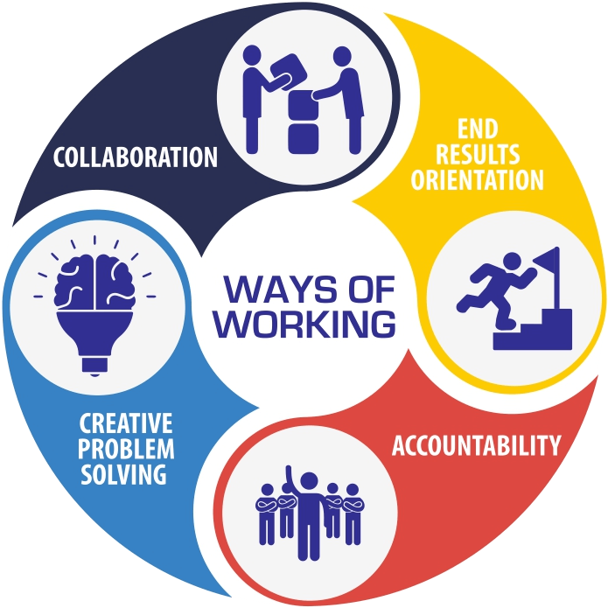
THE "WOW" IN OUR SOLUTION
Our Ways of Working defines who we are, what we stand for, and how we behave.
It is also our compass, guiding us towards our goals while governing our actions and the yardstick that evaluates our success
3/21/2024 Annual Review
‹#›

Slide 10
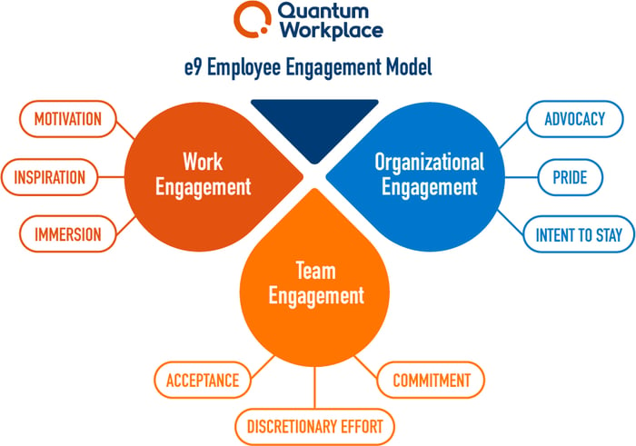
MODELLING
Employee analysis modeling is a way to predict how employees will perform based on a variety of variables. Some factors that can be considered when modeling employee performance include:
Work environment: How satisfied employees are with their bosses, coworkers, and work-life balance
Experience: How much experience employees have and how long they've been with the company
Training and education: What training and education employees have that supports them at work
‹#›

Slide 11
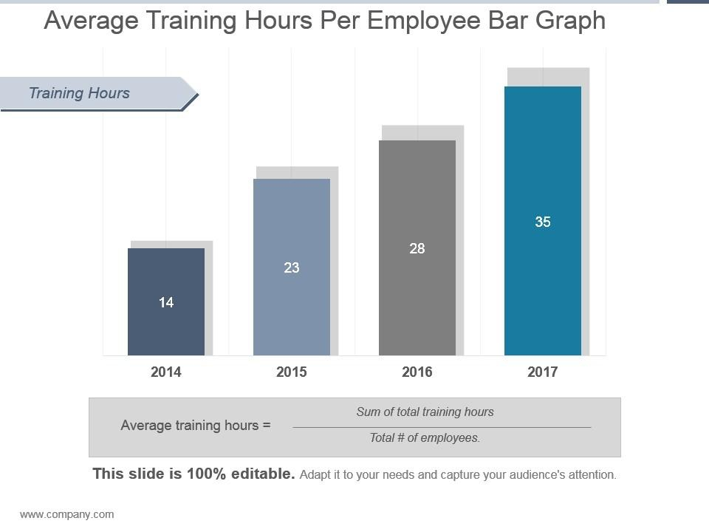
RESULTS
‹#›

Slide 12

conclusion
Data analysis helps researchers draw meaningful and evidence-based conclusions from their research findings. It provides a quantitative basis for making claims and recommendations

